Slide 1

Wireless Networks and MOBILE Computing
BY Mr. VALENS NSENGIYUMVA
Communication Systems Engineer, Sweden
Telephone: 0787288628
Email: vnsengiyumva@uok.ac.rw

Slide 2
DAY 1: Introduction to Cellular systems, Frequency Reuse, Trunking
Cellular, Keys terms, The cellular Radio
Cellular Geometry, Handoff, Co-Channel Interference
Adjacent Channel Interference
Blocked calls cleared, Blocked calls delayed and Discussion

Slide 3
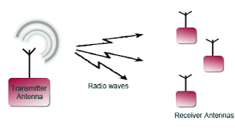
General picture of Wireless Communication

Slide 4
1.2. Cellular

Slide 5
1.2. Key Terms

Slide 6
1.2.
Simultaneous communication on the many channels needed for many pairs of radios to communicate can be accomplished by one of the following:
Time-division multiple access (TDMA) is a channel access method for shared-medium networks. It allows several users to share the same frequency channel by dividing the signal into different time slots. The users transmit in rapid succession, one after the other, each using its own time slot.
FDMA (frequency division multiple access) is the division of the frequency band allocated for wireless cellular telephone communication into 30 channels, each of which can carry a voice conversation or, with digital service, carry digital data.
Code-division multiple access (CDMA) is a channel access method used by various radio communication technologies. CDMA is an example of multiple access, where several transmitters can send information simultaneously over a single communication channel.

Slide 7
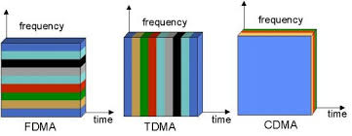

Slide 8
1.2.
Parts of a cellular system:
1. PSTN : The public switched telephone network is the aggregate of the world's circuit-switched telephone networks that are operated by national, regional, or local telephony operators, providing infrastructure and services for public telecommunication

Slide 9
1.2.

Slide 10
1.2.

Slide 11
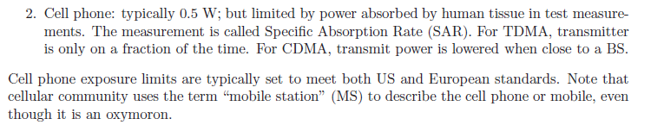
1.4. Cellular RADIO

Slide 12
2. FREQUENCY REUSE
2.1. Cellular Geometry
n: Path loss exponent

Slide 13
2.1.

Slide 14
2.1.

Slide 15
2.1.1. Channel ASSIGNEMENT WITH GROUPS

Slide 16
2.1.1

Slide 17
2.1.1.

Slide 18
2.1.1

Slide 19
2.2.Handoff

Slide 20
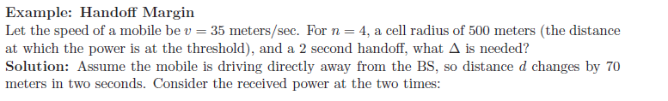
2.2.

Slide 21
2.2.

Slide 22
2.2.

Slide 23

2.3.CO-channel Interference

Slide 24

2.3.

Slide 25
2..3

Slide 26

2.3.1. Downtilt

Slide 27

2.3.1

Slide 28
2.4. Adjacent channel interference

Slide 29
2.4.

Slide 30
3. TRUNKING

Slide 31
3.

Slide 32
3.1. Blocked call cleared

Slide 33
3.2. Blocked calls delayed

Slide 34
3.2.

Slide 35
3.2.

Slide 36
End of day 1
THANK YOU

